Slide 1
Probabilistic Finite-State Automata

Slide 2
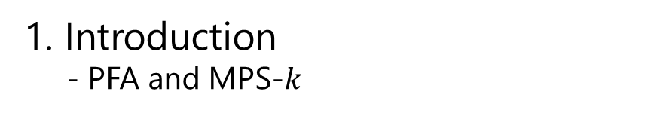
CONTENTS
1. Introduction
- PFA and MPS-$k$
2. Algorithms
3. Implementations
- the PFA framework and algorithms
4. Experiments
5. Schedule

Slide 3
Introduction

Slide 4
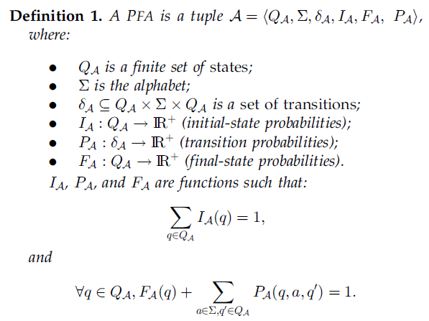
Probabilistic Finite-State Automata
PFA: generative model
NFA/DFA: acceptance model

Slide 5
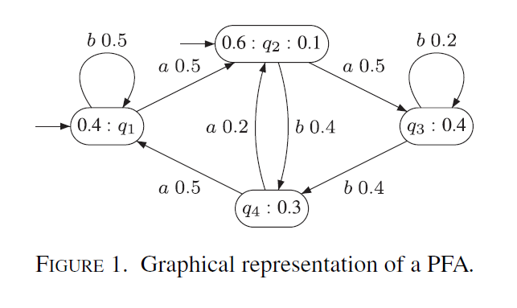
Probabilistic Finite-State Automata

Slide 6
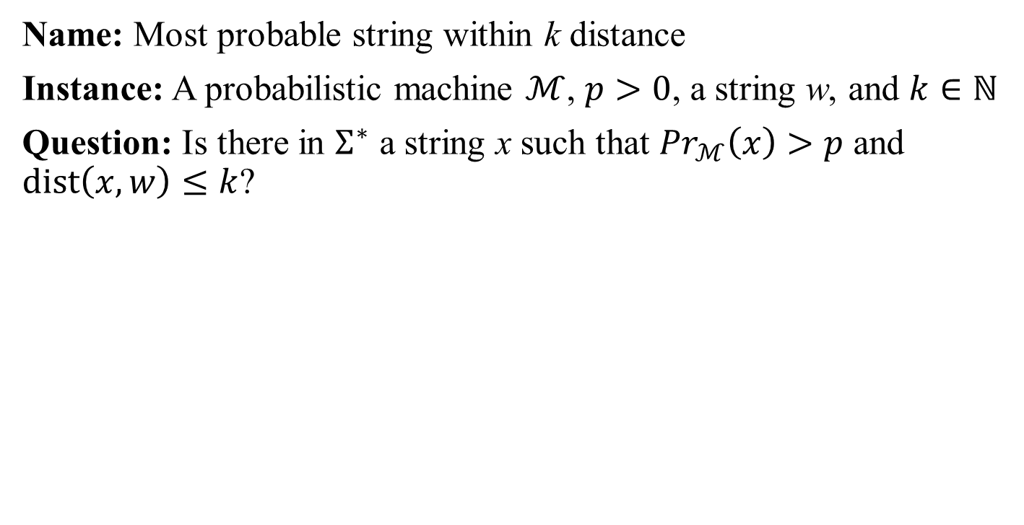
MPS within k distance
Name: Most probable string within k distance
Instance: A probabilistic machine $ℳ$, $p>0$, a string w, and $k∈ℕ$
Question: Is there in $Σ^{∗}$ a string x such that ${Pr}_{ℳ}\left(x\right)>p$ and $dist\left(x,w\right)≤k$?
Distance measurements:
Hamming distance: replace
Edit distance: replace, insert, delete

Slide 7
Algorithms

Slide 8
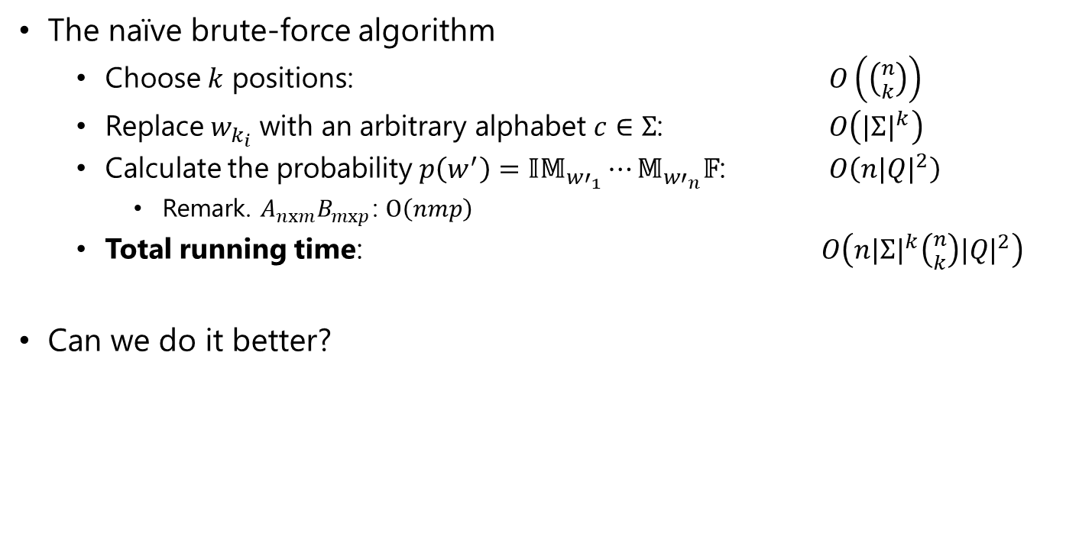
Brute-Force Algorithm
The naïve brute-force algorithm
Choose $k$ positions: $O\left(\left({n \atop k}\right)\right)$
Replace $w_{k_{i}}$ with an arbitrary alphabet $c∈Σ$: $O\left({|Σ|}^{k}\right)$
Calculate the probability $p\left(w^{′}\right)=𝕀𝕄_{{w′}_{1}}⋯𝕄_{{w′}_{n}}𝔽$: $O\left(n{|Q|}^{2}\right)$
Remark. $A_{nxm}B_{mxp}$: $O\left(nmp\right)$
Total running time: $O\left(n{|Σ|}^{k}\left({n \atop k}\right){|Q|}^{2}\right)$
Can we do it better?

Slide 9
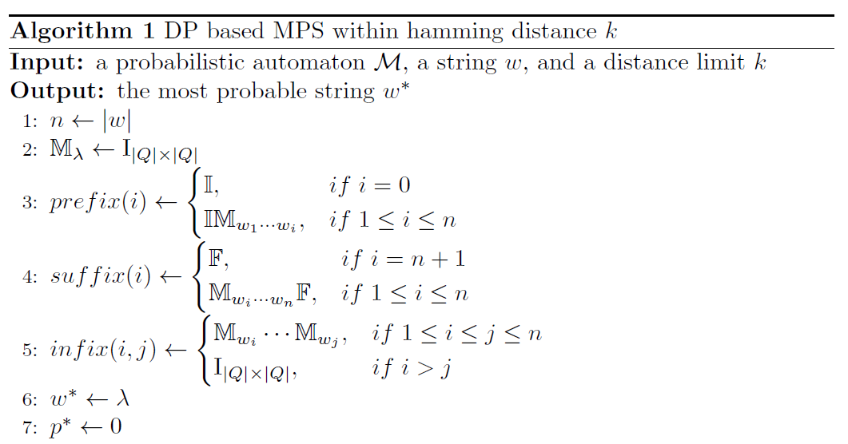
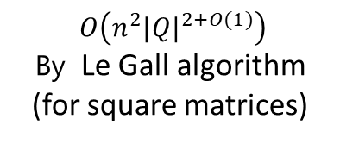
DP based Algorithm
$O\left(n^{2}{|Q|}^{2+O(1)}\right)$
By Le Gall algorithm
(for square matrices)

Slide 10
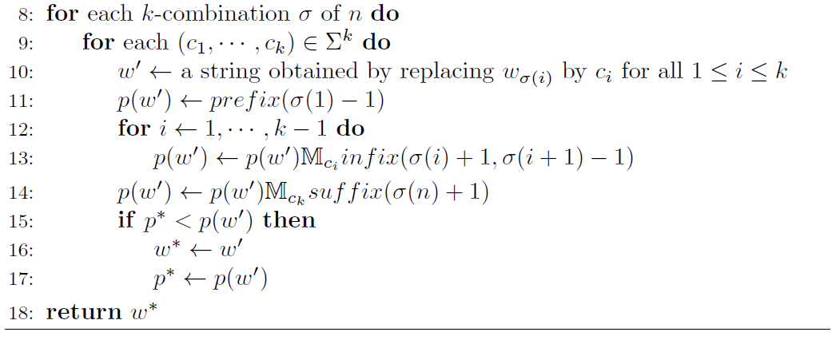
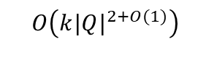
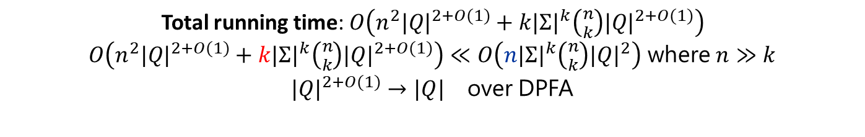
DP based Algorithm
$$O\left(k{|Q|}^{2+O(1)}\right)$$
Total running time: $O\left(n^{2}{|Q|}^{2+O(1)}+k{|Σ|}^{k}\left({n \atop k}\right){|Q|}^{2+O(1)}\right)$
$O\left(n^{2}{|Q|}^{2+O(1)}+k{|Σ|}^{k}\left({n \atop k}\right){|Q|}^{2+O(1)}\right)≪O\left(n{|Σ|}^{k}\left({n \atop k}\right){|Q|}^{2}\right)$ where $n≫k$
${|Q|}^{2+O(1)}→{|Q|}^{}$ over DPFA

Slide 11
Implementations

Slide 12
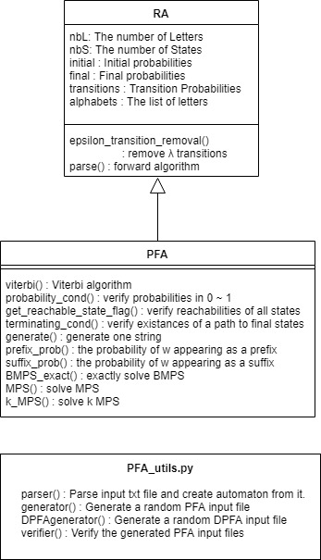
PFA Framework

Slide 13
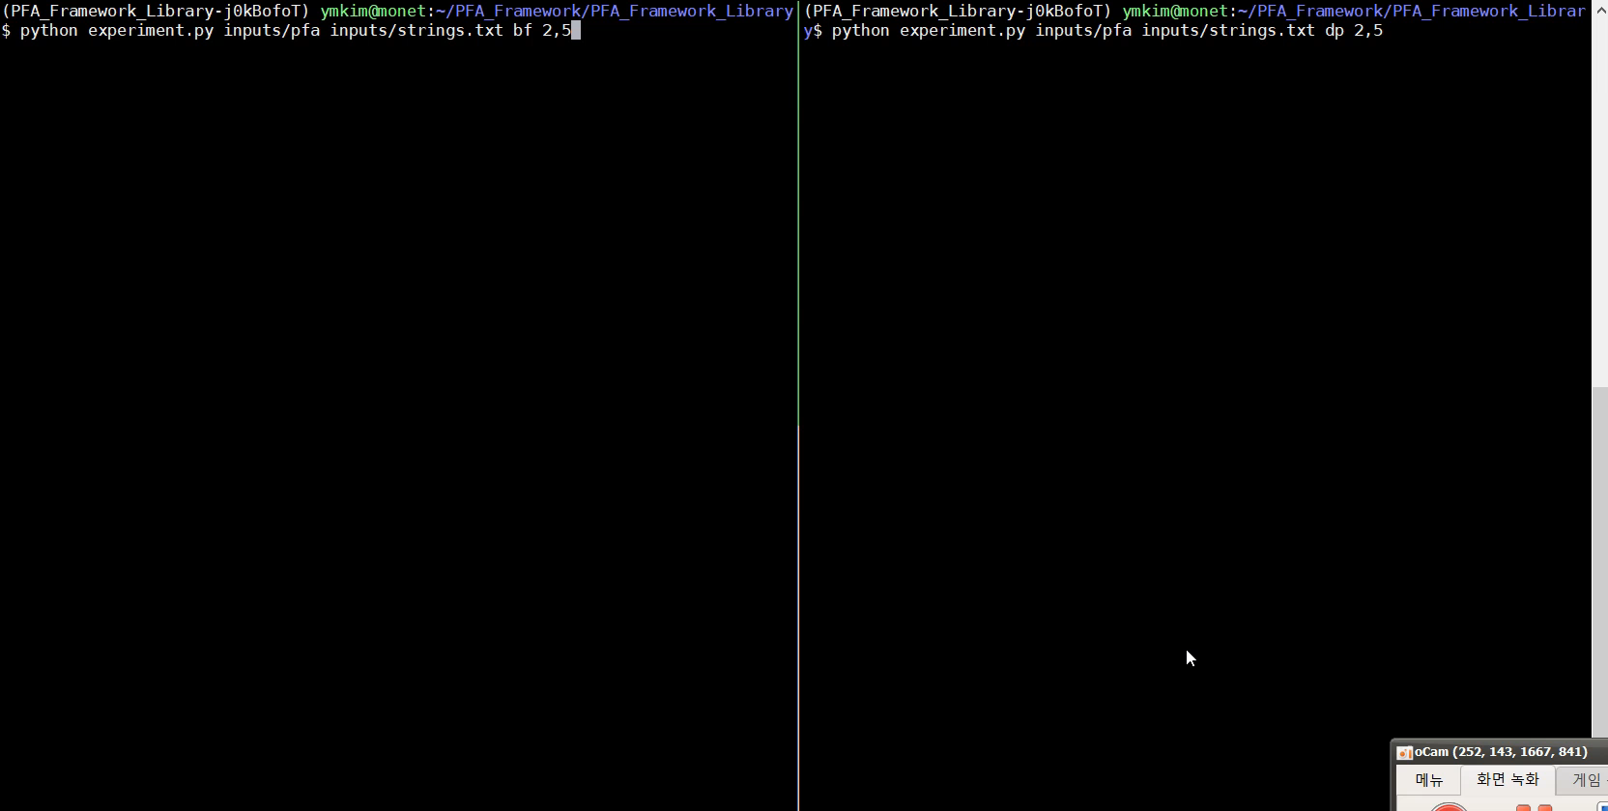
Implementations

Slide 14
Experiments

Slide 15
Experimental Settings
Sample DPFA (10) and strings (100)
n: 5~50 (step=5)
k: 2~5 (step=1)

Slide 16
Experimental Results
k = 1 |  |  | k = 2 |  |  | k = 3
n | running time |  | n | running time |  | n | running time
 | BF | DP |  | BF | DP |  | BF | DP
5 | 0.0025 | 0.0002 | 5 | 0.1162 | 0.0193 | 5 | 2.9591 | 0.7158
10 | 0.0073 | 0.0010 | 10 | 0.8678 | 0.0901 | 10 | 59.6547 | 8.7642
15 | 0.0154 | 0.0027 | 15 | 2.8484 | 0.2154 | 15 | 318.7293 | 34.5413
20 | 0.0265 | 0.0063 | 20 | 6.7667 | 0.3967 | 20 | 1018.6748 | 87.5791
25 | 0.0403 | 0.0115 | 25 | 12.5370 | 0.6274 | - | - | -
30 | 0.0570 | 0.0199 | 30 | 21.4941 | 0.9182 | - | - | -
35 | 0.0784 | 0.0309 | 35 | 34.3092 | 1.2618 | - | - | -
40 | 0.1038 | 0.0462 | 40 | 50.6202 | 1.6674 | - | - | -
45 | 0.1281 | 0.0656 | 45 | 72.3012 | 2.1089 | - | - | -
50 | 0.1592 | 0.0900 | 50 | 98.3452 | 2.6199 | - | - | -

Slide 17
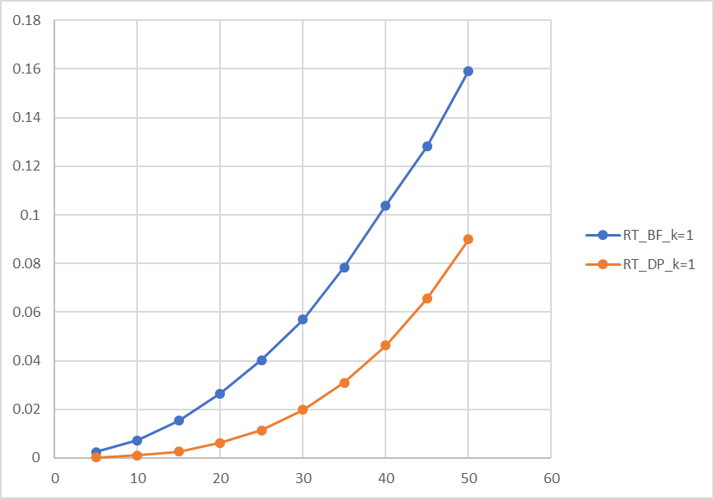
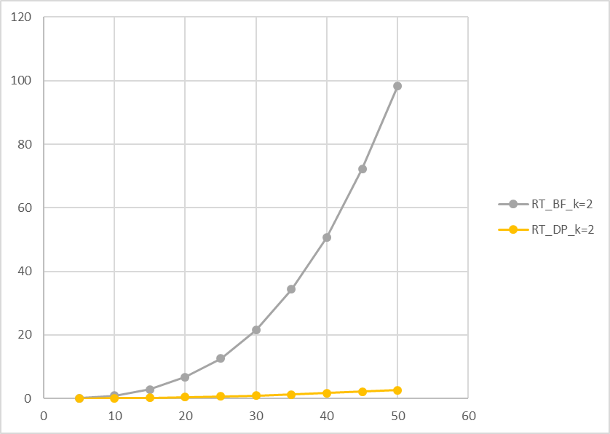
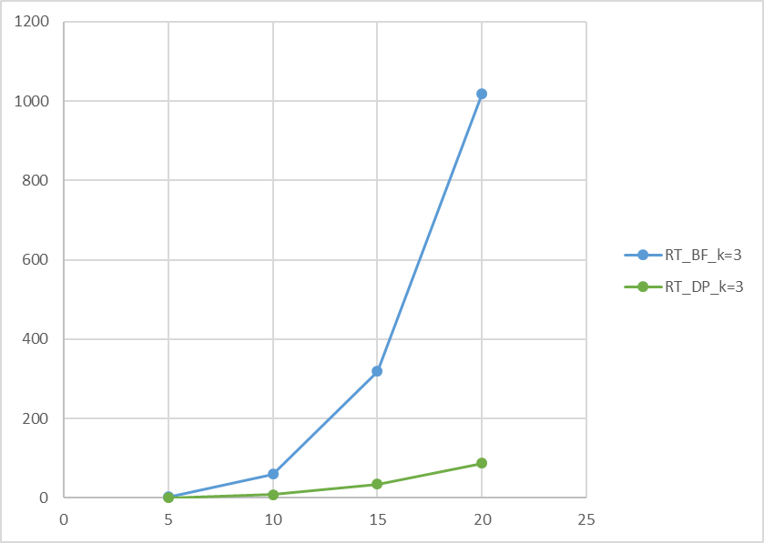
Experimental Results
k = 1
k = 2
k = 3

Slide 18
Schedule

Slide 19
Schedule
To do:
Design a tractable algorithm for MPS-k (next presentation)
Implement it (next presentation)
Compare it with the DP based algorithm (final presentation)
Analyze them and decide “when to use which” (final presentation)

